Slide 1

US Accident Data Analysis
A Data-Driven Safety Report
P Jaya Krishna Reddy

Slide 2
Why This Analysis Matters
Problem Statement:
Accidents continue to be a major concern for public health and road safety.
Over 7.7 million accident records from the US dataset provide insight into the causes, frequency, and severity of road accidents.
Goal:
Identify trends and patterns in accidents over time and across locations.
Understand environmental and infrastructure factors influencing accident severity.
Provide actionable recommendations for improving road safety.

Slide 3
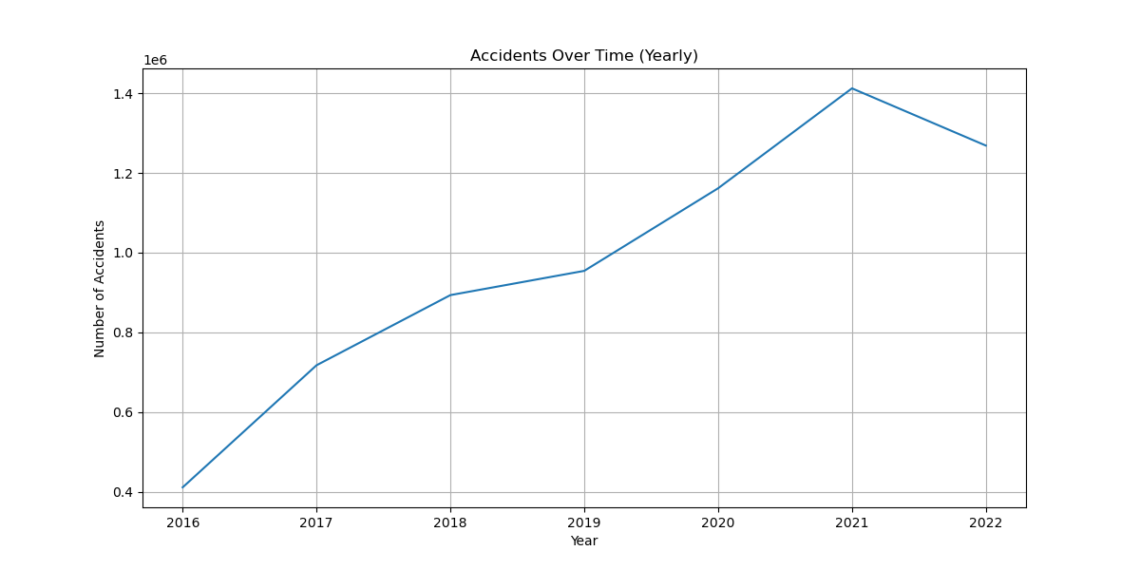
Accidents Over Time “How Have Accidents Changed Over the Years?”

Slide 4
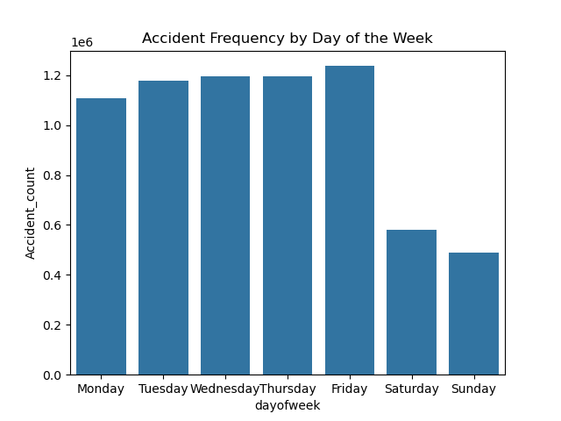
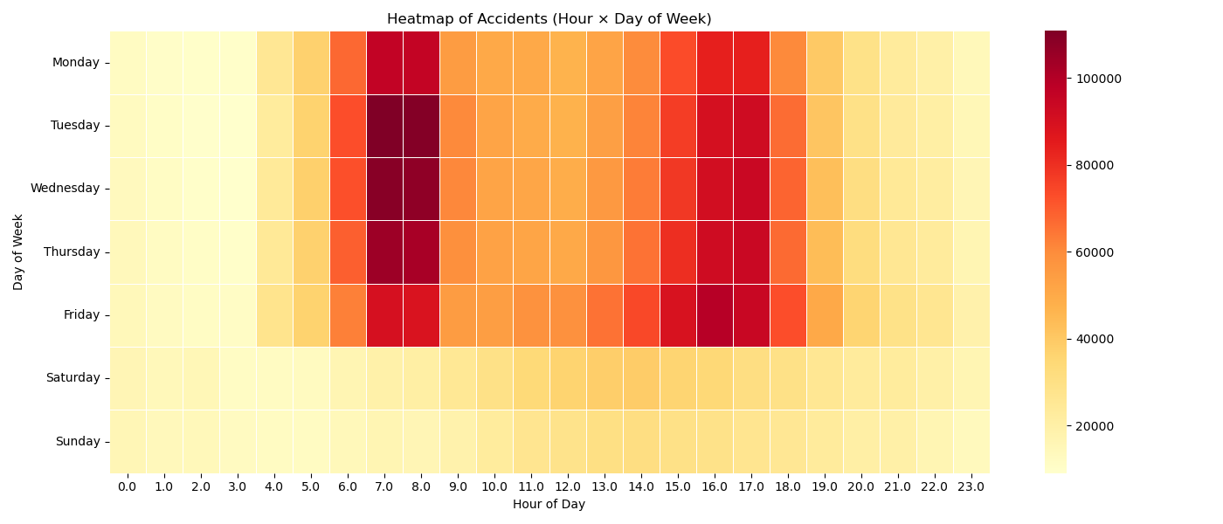
Accidents Over Time “Are Roads Riskier on Weekdays?”

Slide 5
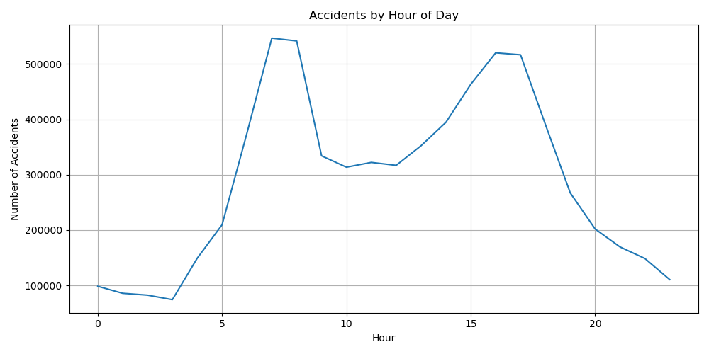
Accidents Over Time “When Do Most Accidents Occur?”

Slide 6
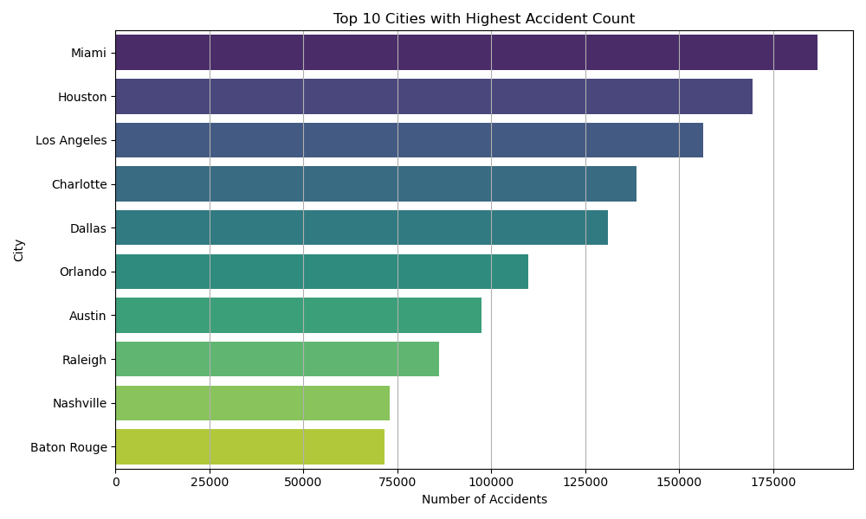
Top 10 Cities by Accident Count “Where Are the Urban Hotspots?”

Slide 7
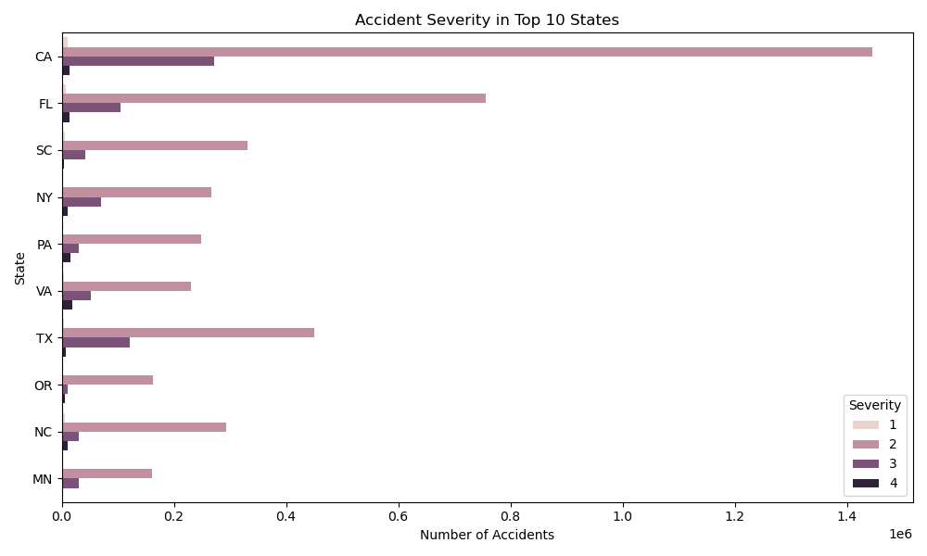
Top 10 States by Accident Count “Where Are the Urban Hotspots?”

Slide 8
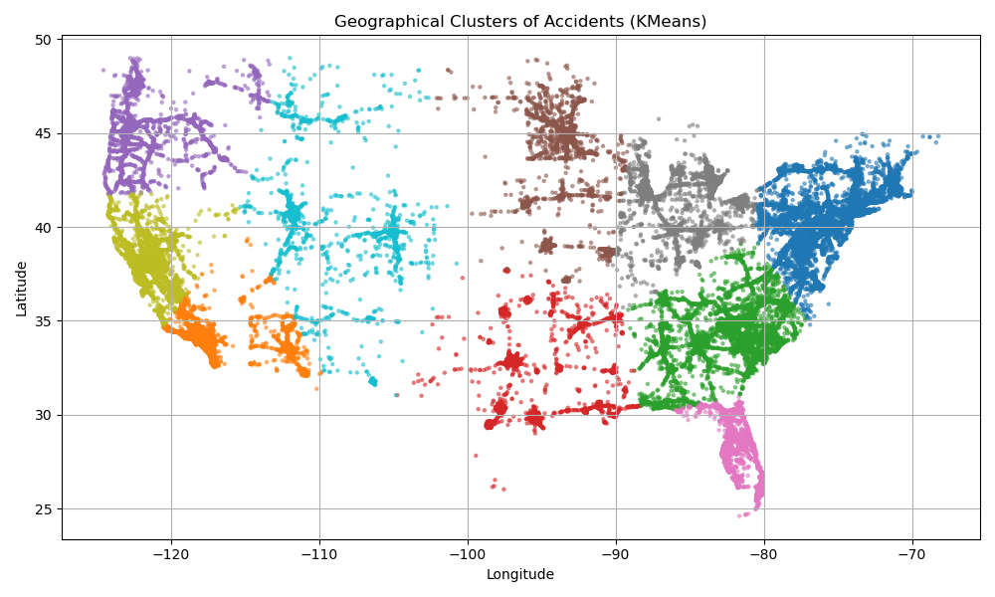
US State-wise Distribution “Accident Density”

Slide 9
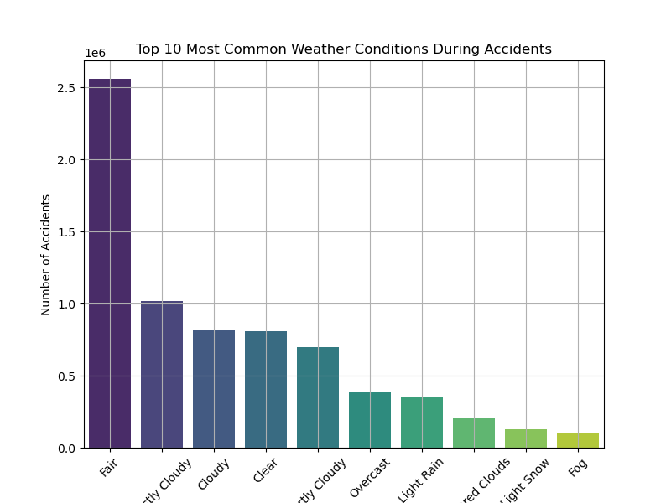
Weather Conditions “Does Bad Weather Cause More Accidents?”

Slide 10
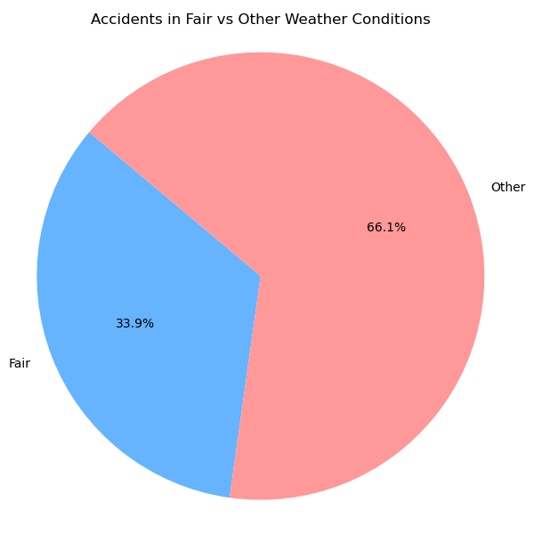
Fair vs Other Weather “Surprising Weather Insight: Most Accidents in Fair Conditions”

Slide 11
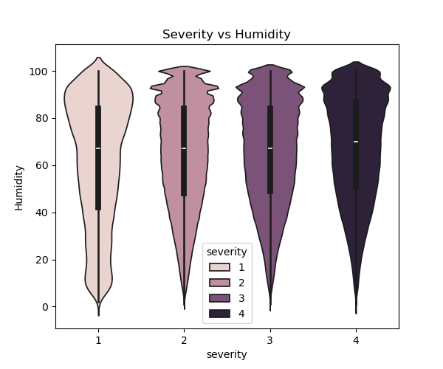
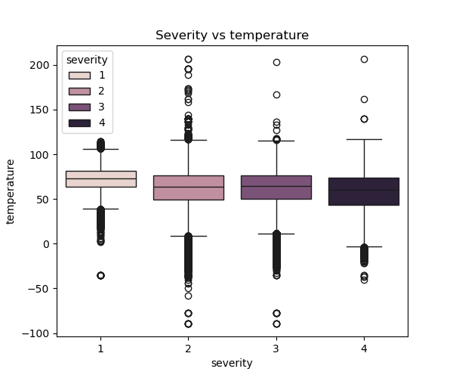
Environmental Factors (Subplots) “Do Temperature and Humidity Affect Severity?”

Slide 12
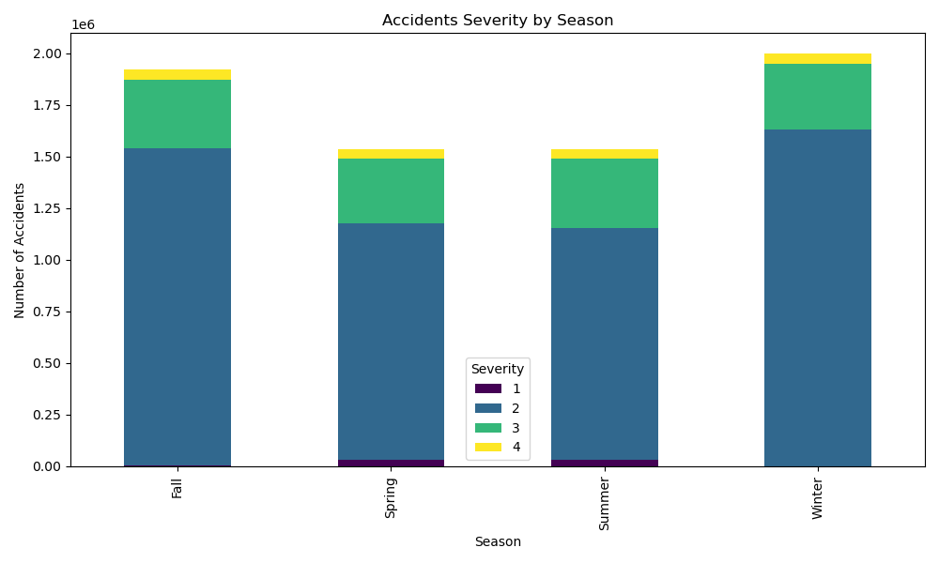
Accident Severity by Season “Seasonal Severity Trends”

Slide 13
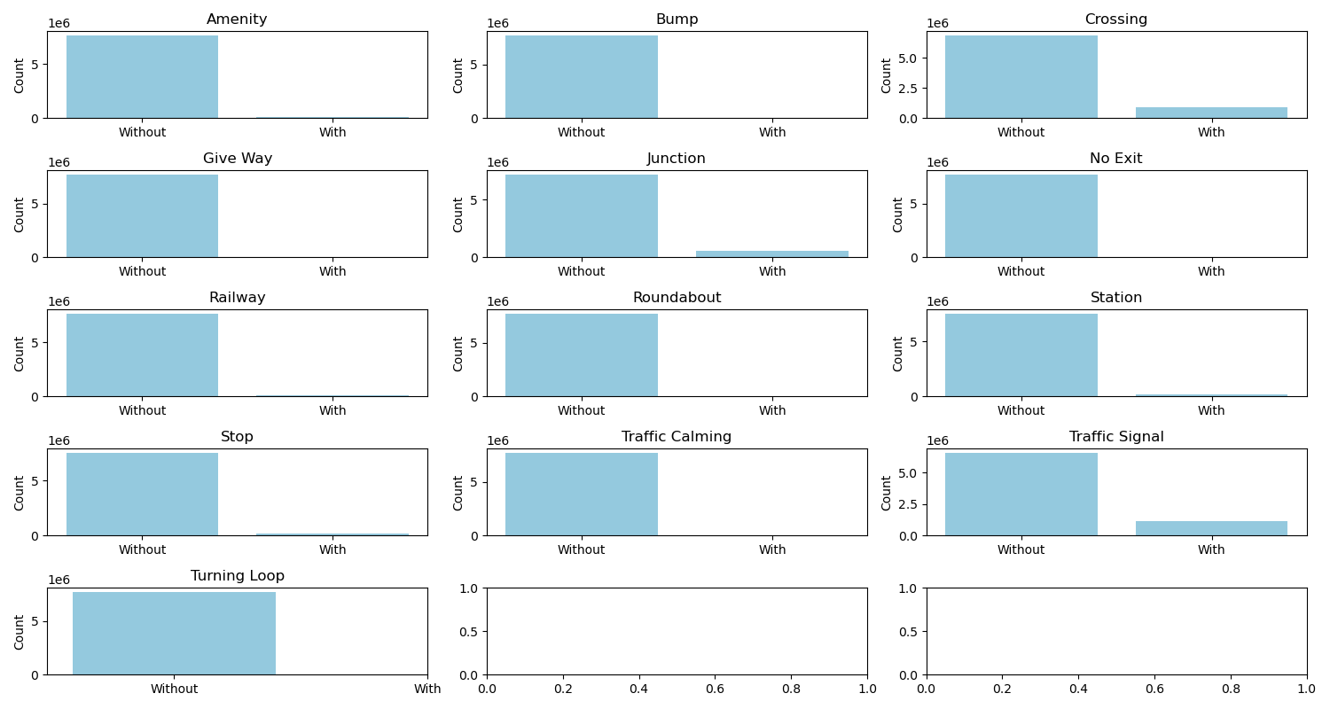
Road Features & Severity “Impact of Road Infrastructure on Accidents”

Slide 14
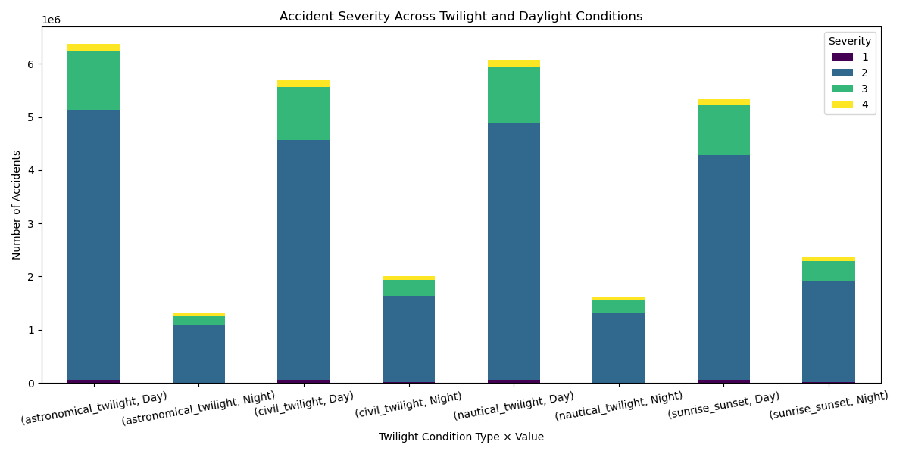
Twilight & Daylight Conditions “Does Light Condition Affect Crash Severity?”

Slide 15
Conclusion & Next Steps
Road accidents remain a major public safety concern across the United States, with millions of incidents recorded over the years.
Through detailed EDA of the US Accidents dataset, we've uncovered critical insights about:
Time patterns (peak hours, weekdays)
High-risk locations and cities
Weather-related accident severity
Impact of road infrastructure (e.g., junctions, traffic signals)
The patterns show that preventable factors—like poor visibility, infrastructure gaps, and weather—significantly influence accident severity and frequency.
.

Slide 16
Conclusion & Next Steps
Collaborate with city/state transportation authorities to target high-incident zones.
Prioritize infrastructure upgrades: crossings, better lighting, more signals.
Integrate weather and traffic systems for real-time risk alerts.
Launch public awareness campaigns based on top causes and trends.
Recommend further studies using ML models to predict high-risk zones
.

Slide 17


